Slide 1
Final Project Presentation
18102082 Su Kyoung Oh
18102092 Won Ryeol Jeong
16102284 Sung Ho Lee

Slide 2
Contents
Goal
Crawling
Preprocessing
Train Model(Naive Bayes)
Evaluate Model(Naive Bayes)
Coefficient
K-means Clustering

Slide 3
Goal
Our project goal is to compare and find insights of Korean and foreigner’s restaurant reviews through Mangoplate and Tripadvisor
Through analyzing the reviews, we compare the difference in Koreans and foreigners’ perspective in evaluating restaurants regarding taste of the food, price, service quality and atmosphere features by using Naive Bayes model’s coefficient, word cloud and K-means clustering.

Slide 4
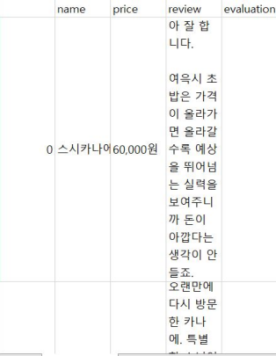
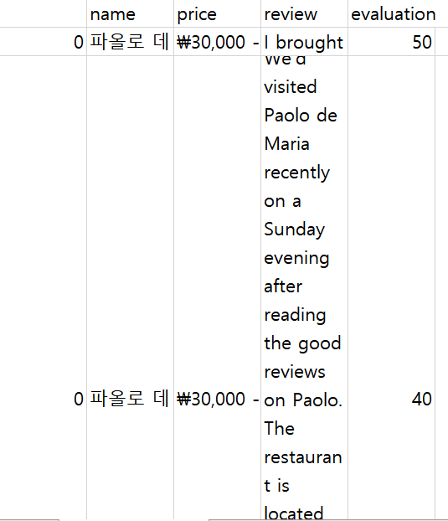

Crawling
We crawled the reviews of Gangnam-gu, Mapo-gu restaurants from MangoPlate (Korean reviews) and Tripadvisor (English reviews)

Slide 5
Preprocessing (1): TextRank Algorithm
The Tf-Idf matrix and its transposition matrix is multiplied to obtain the correlation matrix. Through the correlation matrix, the weighted graph between reviews or words can be expressed. We applied the TextRank algorithm using the weighted graph of the words generated.
Through the TextRank algorithm, we sort the words in order of highest Ranking value and create a set of words that represent the reviews of that class. The presence of these selected words was investigated and applied to the Naïve Bayes model.

Slide 6
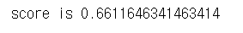
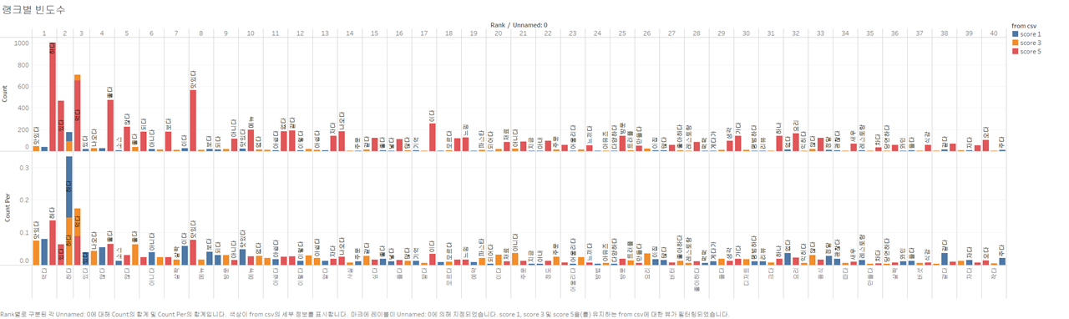
Preprocessing (1): TextRank Algorithm
The result of the preprocessing using tf-idf was not good regarding the performance of dividing positive and negative reviews.
Moreover, We cannot find any insight from result Data visualization

Slide 7
Preprocessing (2): Using N gram
We thought that in order to find and compare the certain words related to taste, service, price, and atmosphere in Korean and foreigners’ reviews, the correlation between words was necessary.
That is why we built the model again using N-gram method to find the correlation between the words.

Slide 8
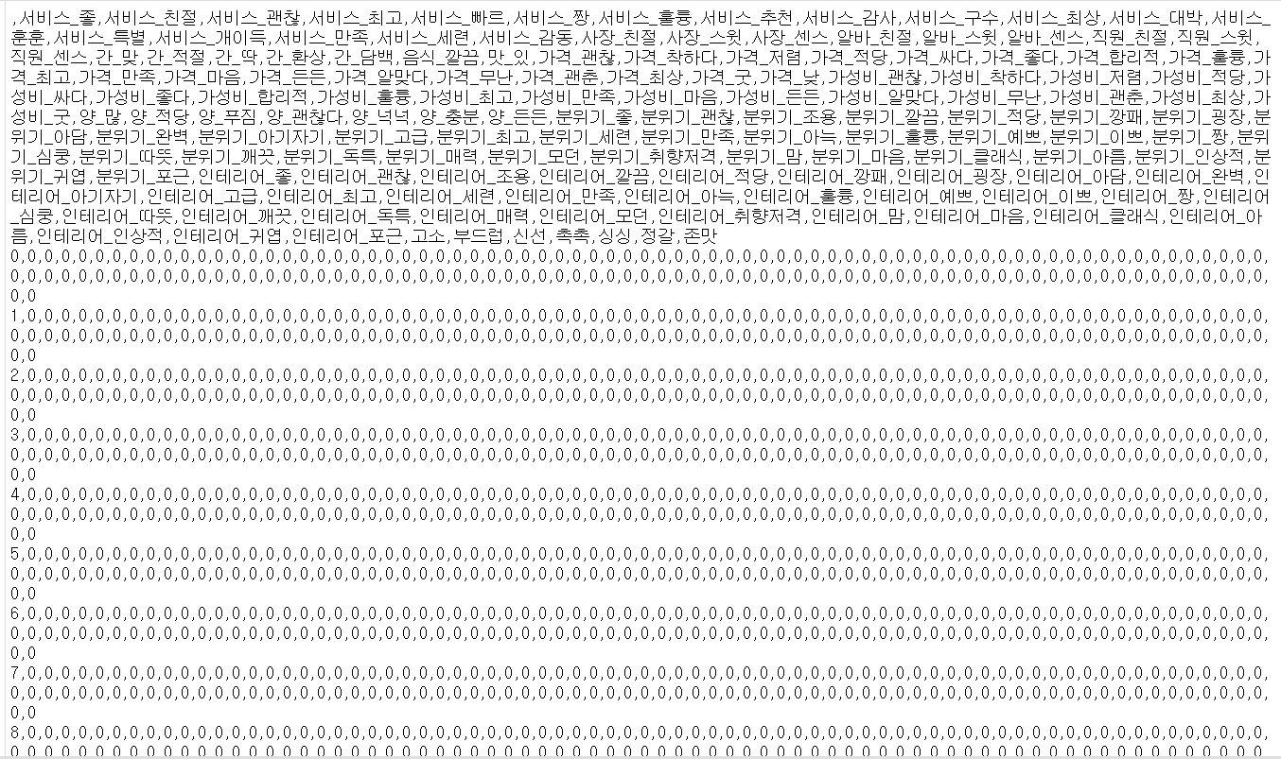
Preprocessing (2): Using N gram
We grouped n words together and tokenize them to find a correlation between the words or words.

Slide 9
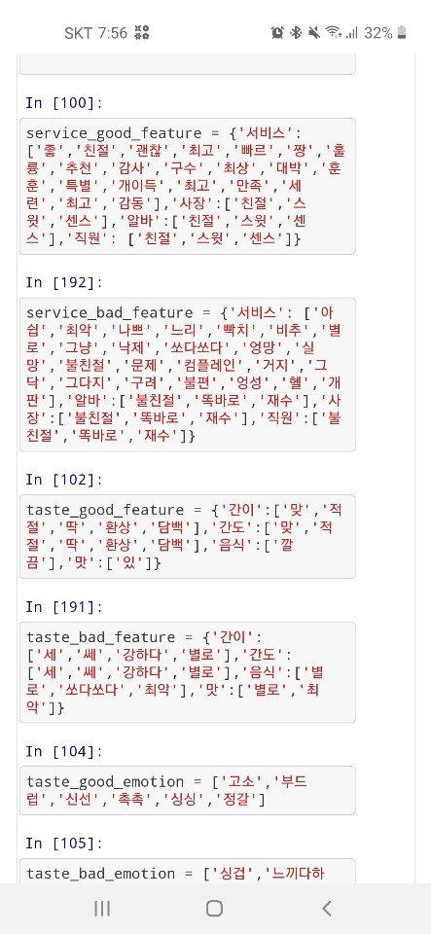
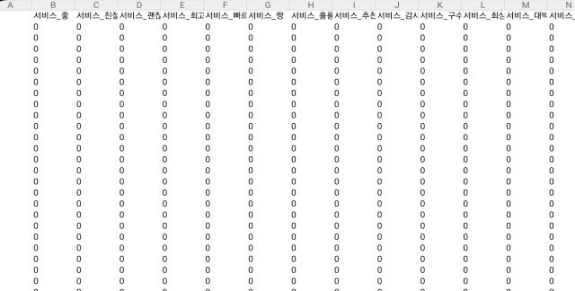
Preprocessing (2): Using N gram
We tried to use Ngram for preprocessing the reviews as below, but the result was meaningless. Even when using 4-grams, only 31 of them were true (1).

Slide 10
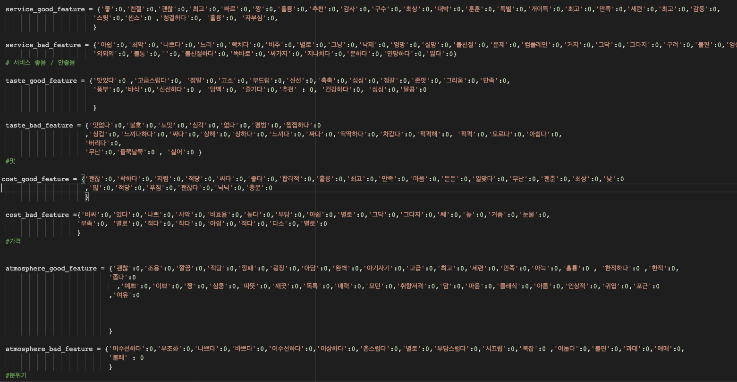
Preprocessing (3) : Keywords of 4 features
Korean:
We made good/bad keywords of 4 features by personally looking through the mangoplate and tripadvisor reviews
Service
Taste
Cost
Atmosphere

Slide 11
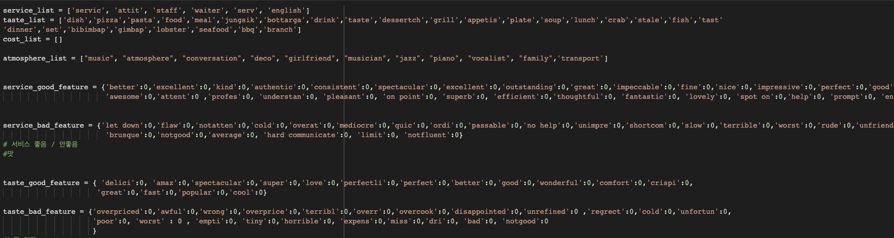
Preprocessing (3) : Keywords of 4 features
English:

Slide 12
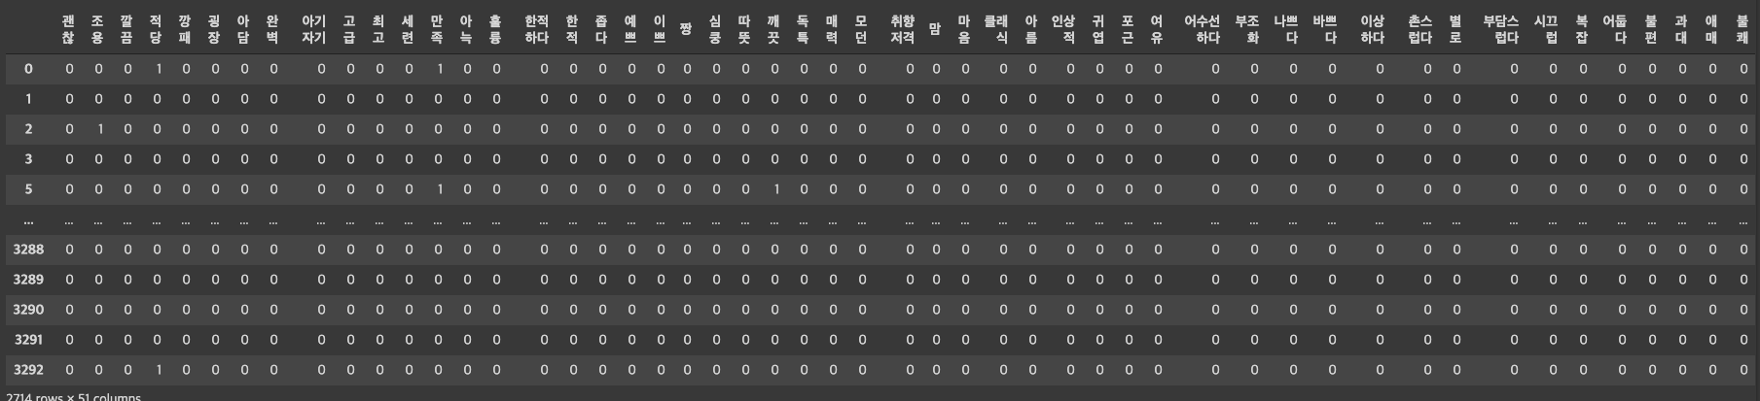
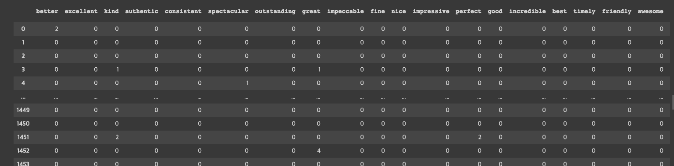
Preprocessing (3) : Keywords of 4 features

Slide 13
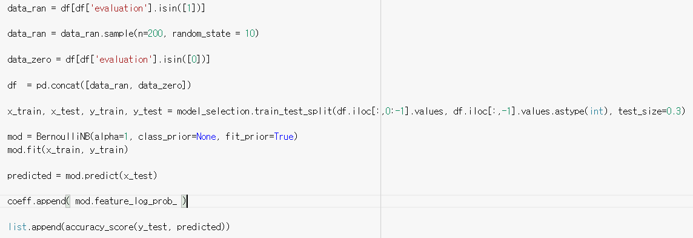
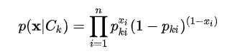
Training Model (Naive Bayes)

Slide 14
Evaluating Model (Naive Bayes)
 | Tripadvisor | MangoPlate
Service | 0.6771704545454545 | 0.7598068181818183
Taste | 0.6796136363636363 | 0.735284090909091
Cost | 0.6818068181818182 | 0.7237613636363636
Atmosphere | 0.6765795454545455 | 0.7213068181818181

Slide 15
Coefficient
With the coefficient of this model, we can analysis which word is powerful to sort as positive or negative reviews . They are used for comparison analysis between Korean and English reviews

Slide 16
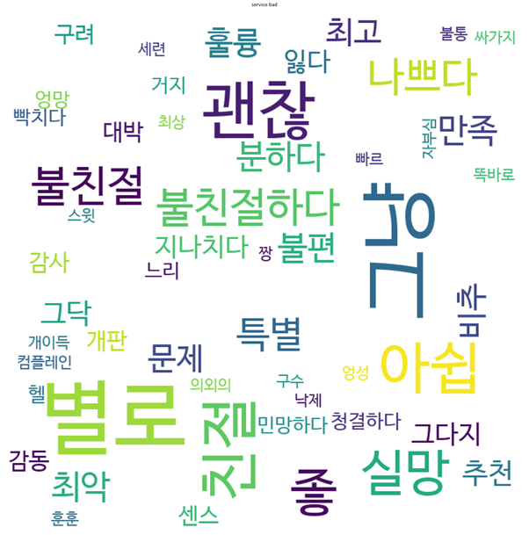
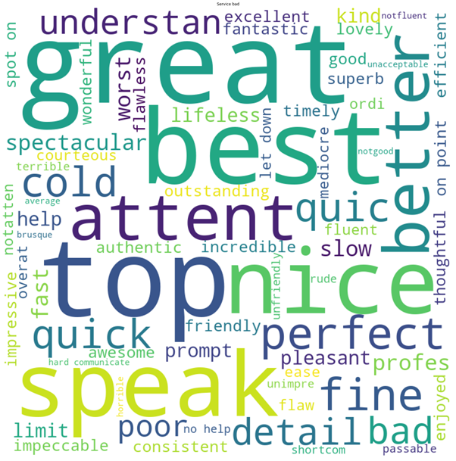
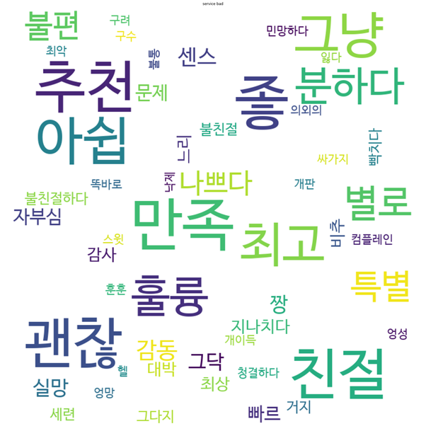
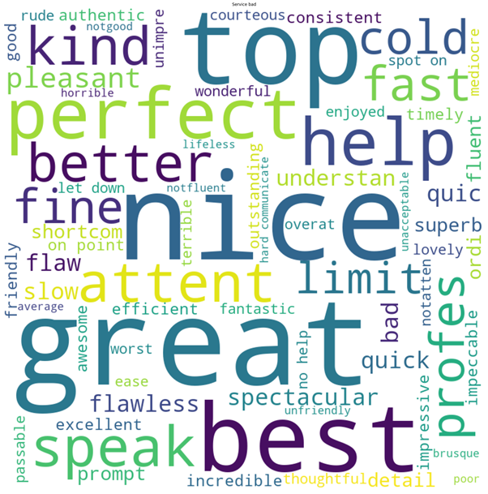
Word Cloud(Service)
Service feature bad Korean
Service feature bad English
Service feature good Korean
Service feature good English

Slide 17
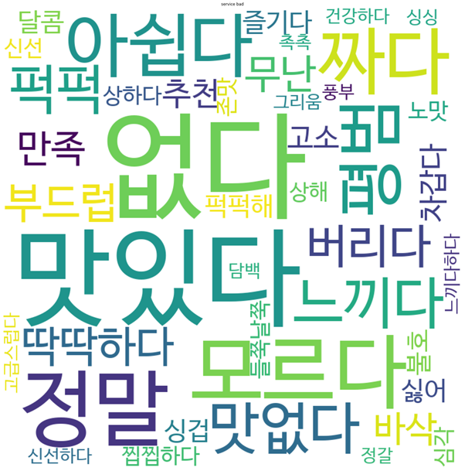
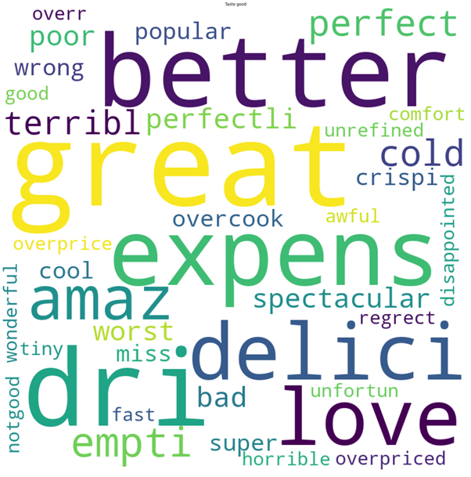
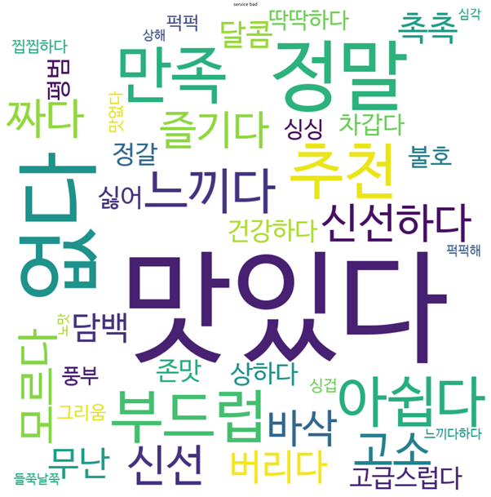
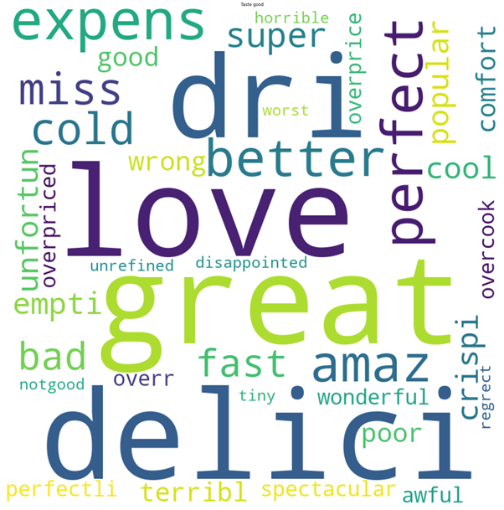
Word Cloud(Taste)
Taste feature bad Korean
Taste feature bad English
Taste feature good Korean
Taste feature good English

Slide 18
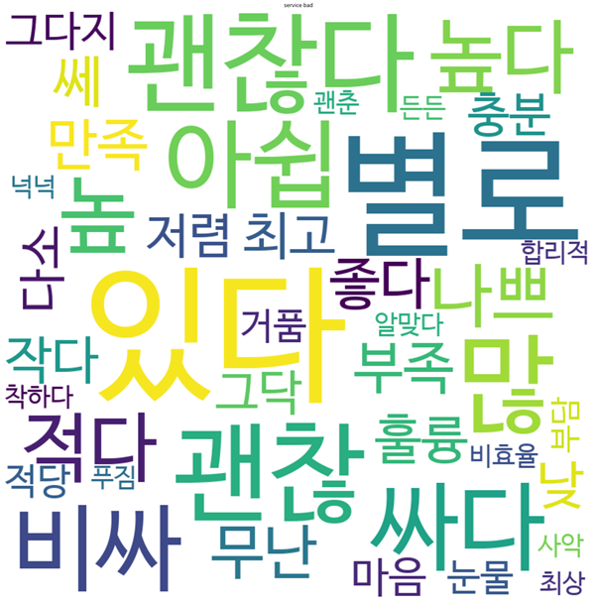
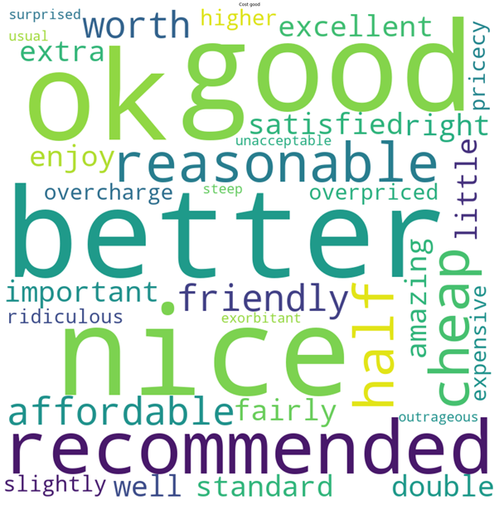
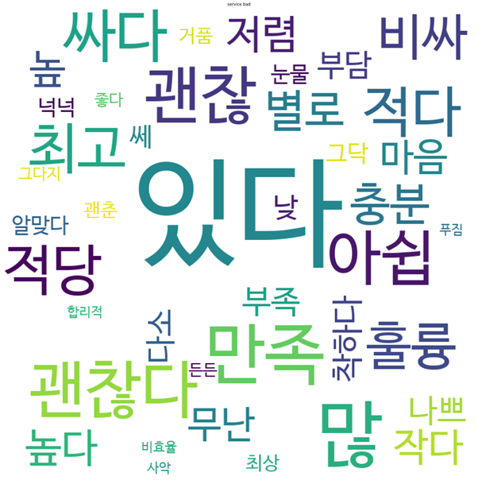
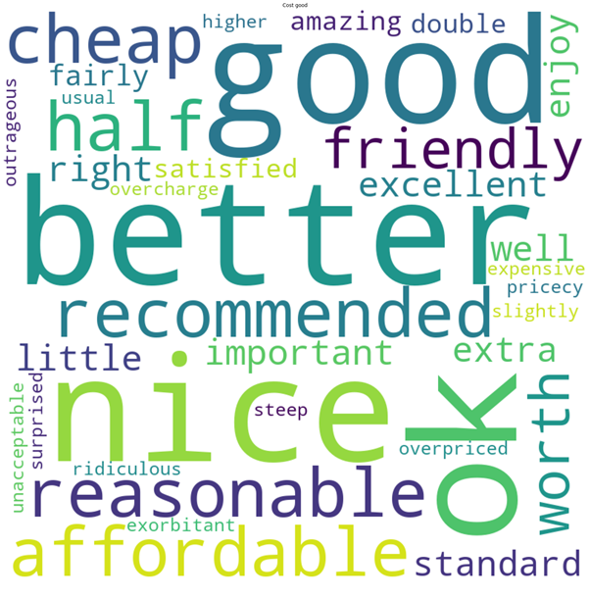
Word Cloud(Cost)
Cost feature bad Korean
Cost feature bad English
Cost feature good Korean
Cost feature good English

Slide 19
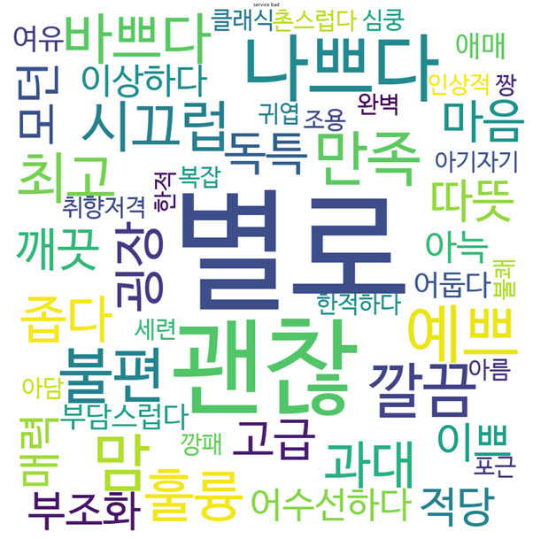
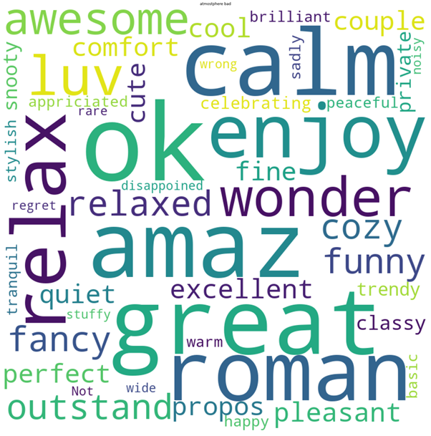
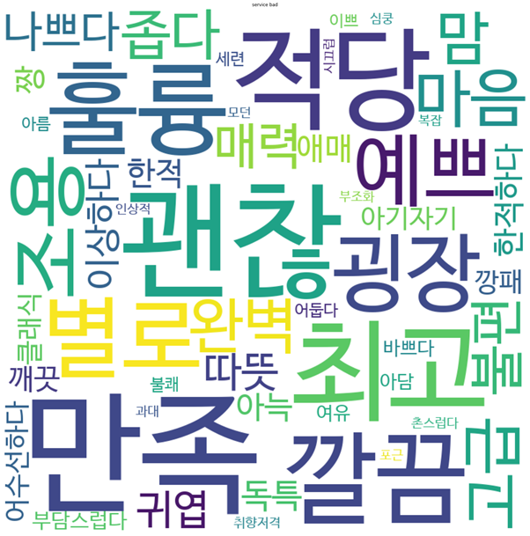
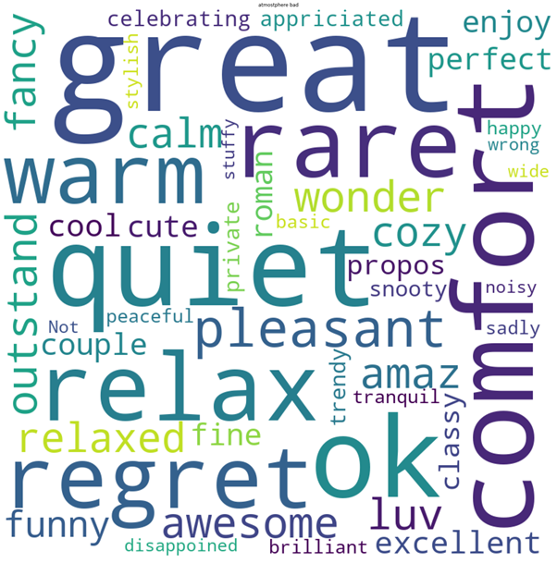
Word Cloud(Atmosphere)
Atmosphere feature bad Korean
Atmosphere feature bad English
Atmosphere feature good Korean
Atmosphere feature good English

Slide 20
Insight
In English reviews, communication, the ability to speak English fluently, was influential in evaluating service feature.(speak, communicate)
In addition, regarding speed, “slow” can be seen on both Korean and English reviews, but the word “fast” can only be seen in English reviews. This might be because Koreans take fast service for granted, while for foreigners regard it as a very good plus in service.

Slide 21
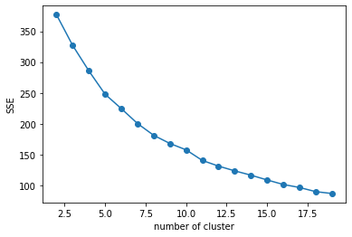
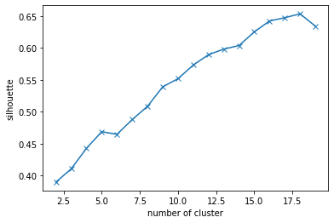
K-Means Clustering
Find pattern using K-means clustering of positive and negative reviews
Firstly, to find out which number of cluster is best, we had used elbow point and silhouette score
ex)

Slide 22


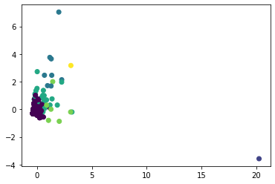
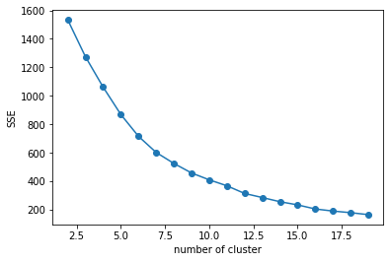
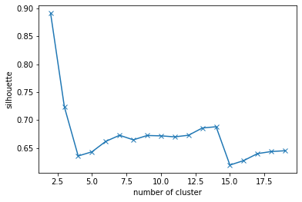
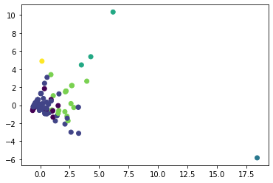
English
service_feature
SSE by clustered number
Silhouette score by clustered number
K-means cluster to visualization
taste_feature

Slide 23
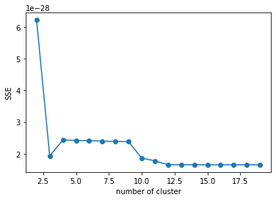
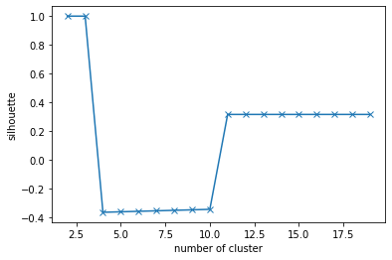
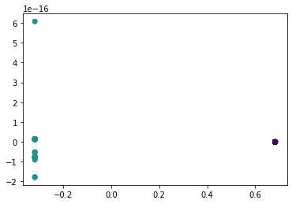
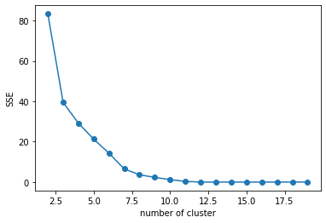
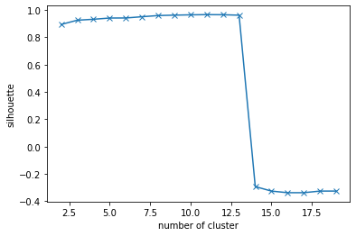
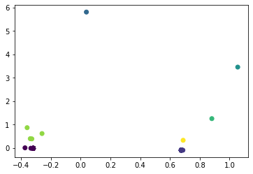
English
cost_feature
SSE by clustered number
Silhouette score by clustered number
K-means cluster to visualization
atmosphere_feature

Slide 24
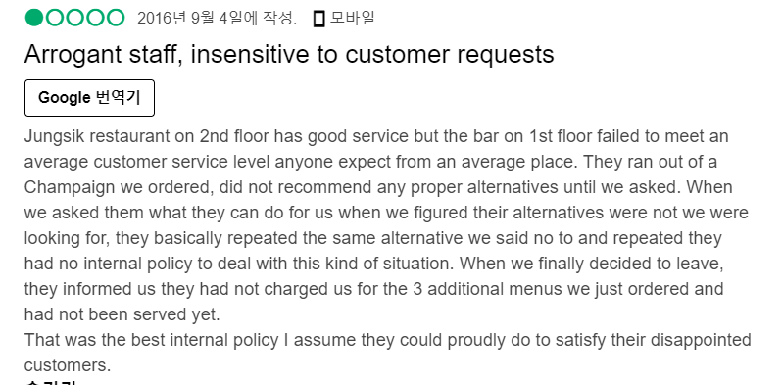
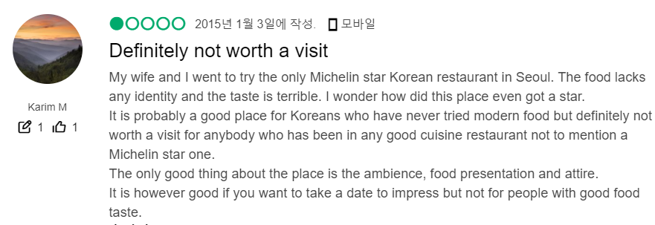
Why ?
We noticed that with English reviews, people tend to write positive words along with negative words even when giving low evaluation
Instead of writing negative words, most of the reviews use “not” with the positive words (bad(x) , not good (O))
Reviews were mostly about service and taste rather than cost and atmosphere

Slide 25

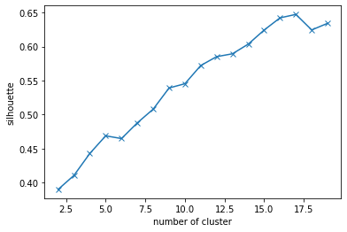
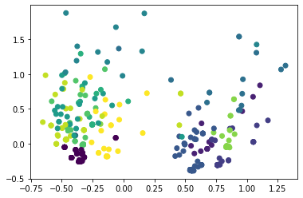
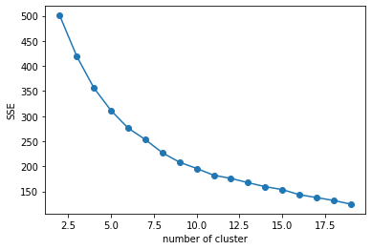
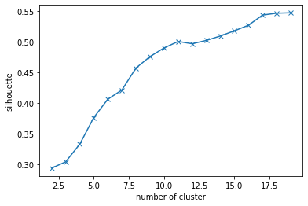
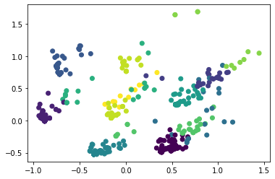
Korean
12 is selected as N_component
service_feature
SSE by clustered number
Silhouette score by clustered number
K-means cluster visualization
taste_feature
11 is selected as N_component

Slide 26
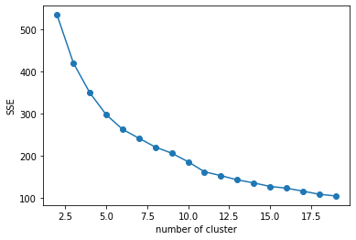
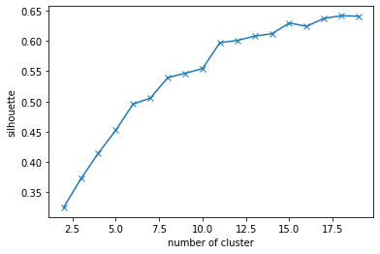




Korean
11 is selected as N_component
cost_feature
SSE by clustered number
Silhouette score by clustered number
K-means cluster visualization
atmosphere_feature
12 is selected as N_component

Slide 27



service_feature_cluster
‘불/친절’ have been clustered
‘그냥’, ‘별로’ : mostly used as negative
‘아쉽’ used a lot → there are disappointing parts even when it is good in overall
‘분하다’ is unexpectedly clustered together

Slide 28



taste_feature_cluster
“평범” , ”아쉽다” → Negative
“짜다" is could be found in various classes.
→ not objective ( depends on person )
“부드럽다” is used with positive words
Taste (ex. salty) depends on person However, we can identify definite positive word and negative word about texture

Slide 29



cost_feature_cluster
Cost was not expressed in various words.
Unexpectedly, ‘싸다’ and ‘비싸다 were often used at the same time.
The contradictory words were used at the same time to enhance its meaning.
Ex) “맛은 좋은데 비싸다" , “양은 적은데 비싸다"

Slide 30



atmosphere_feature_cluster
Unlike Cost feature, words related to mood tend to be come up with negative only or positive only

Slide 31
Insights
English
There were not that much of negative reviews with low evaluation
There were many commonly used words rather than specific words for certain feature, making it hard to separate them. (ex. good, great). Also, the common words were used in both positive and negative reviews
A lot of positive words appear in negative reviews →seems like people wrote positively due to travel.
Korea
Based on many local people reviews , there is clear difference between negative and positive reviews.
However, words that were often used differently than expected existed
ex) “분하다”

Slide 32


